Slide 1



Oddesy Travels
Project Requirement for Travels Agency Software
SOFTWARE
REQUIEMENT
Revolutionizing Travel Planning with Innovative Technology and Personalized Solutions
Explore Now

Slide 2


Oddesy Travels
Introduction
The Odyssey Travel website is designed to provide a comprehensive and user-friendly platform for individuals to plan and book their travel experiences.

Slide 3

Oddesy Travels
Goals and Overview
Provide a wide range of travel packages to cater to diverse preferences and budgets.
Offer easy-to-use tools for booking transportation and accommodations.
Enhance user experience through a responsive and intuitive interface.
Support local economies by connecting travelers with local service providers.
Promote cultural exchange and responsible tourism.

Slide 4
Oddesy Travels
SYSTEM REQUIREMENTS

Slide 5

Oddesy Travels
Functional Requirements
Search and Filter
Payment Processing
View Travel Packages
Transportation Booking
User Registration and Login
Notifications and Alerts
Package Booking
User Profile Management
Hotel Booking
Admin Management

Slide 6


Non Functional Requirements
Oddesy Travels
Pleasant and User-Friendly Interface
Multilingual Support
Fast Response Time
Support for Long Input Lists
No Automatic Alteration of Task List
Instant Restart Without Data Loss
Usable by All Users Regardless of Technical Knowledge

Slide 7


Oddesy Travels
User Requirements Defination
User Registration and Login
Browse and View Travel Packages
Book Travel Packages
Make Secure Payments
Book Hotels

Slide 8

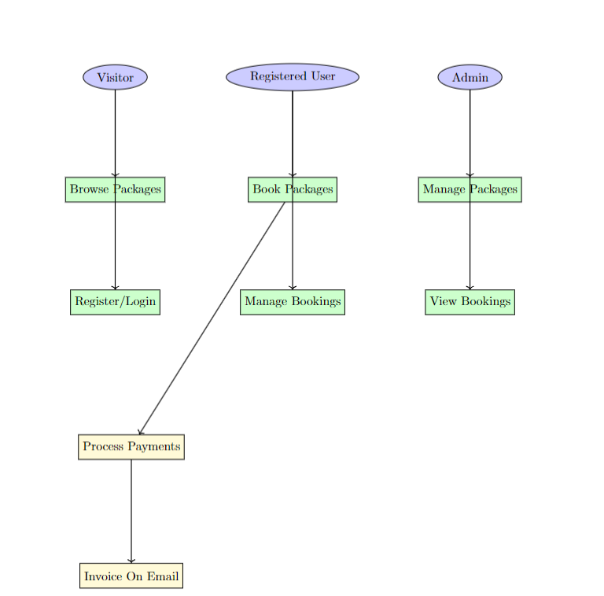
Logical Structure :
Oddesy Travels

Slide 9

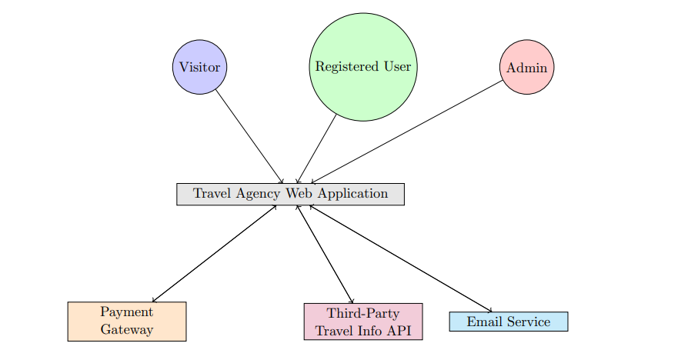
System Environment
Oddesy Travels

Slide 10
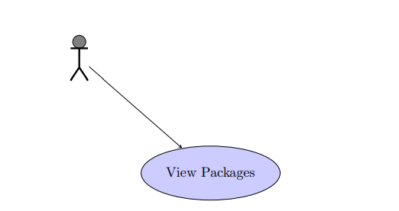
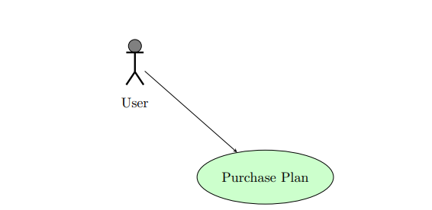
UC 1: Users Viewing Packages
Oddesy Travels
UC 2: Purchase Plan

Slide 11
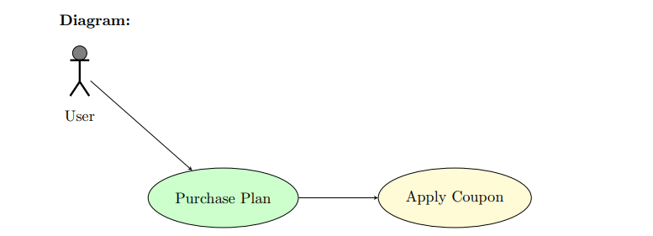
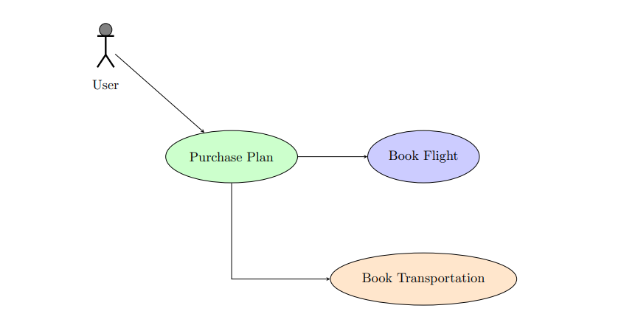
UC 3: Apply Coupon
Oddesy Travels
UC 4: Book Flight and Transportation

Slide 12
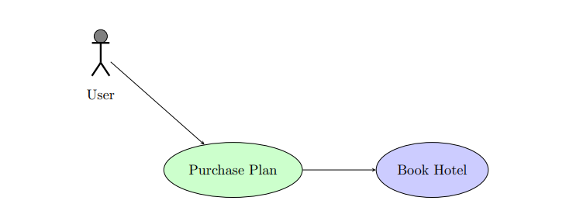
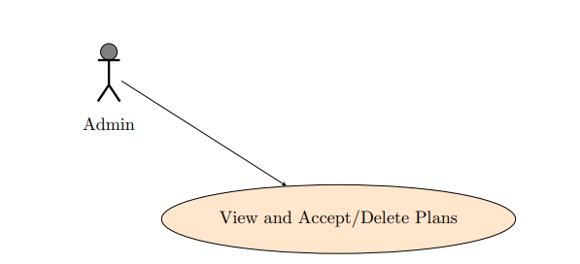
UC 5: Book Hotel
Oddesy Travels
UC 6: Admin View and Accept/Delete Plans

Slide 13
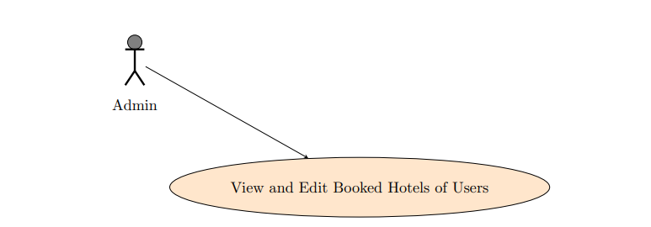
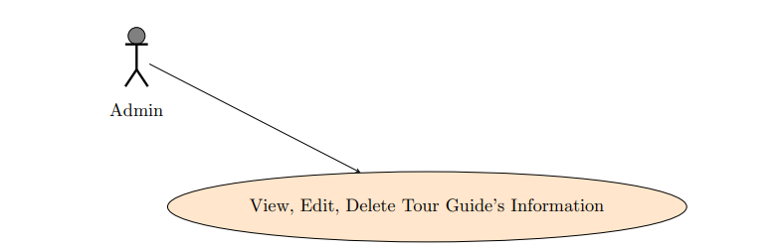
UC 7: Admin View and Edit Booked Hotels of Users
Oddesy Travels
UC 8: Admin View, Edit, Delete Registered Tour Guide’s Information

Slide 14
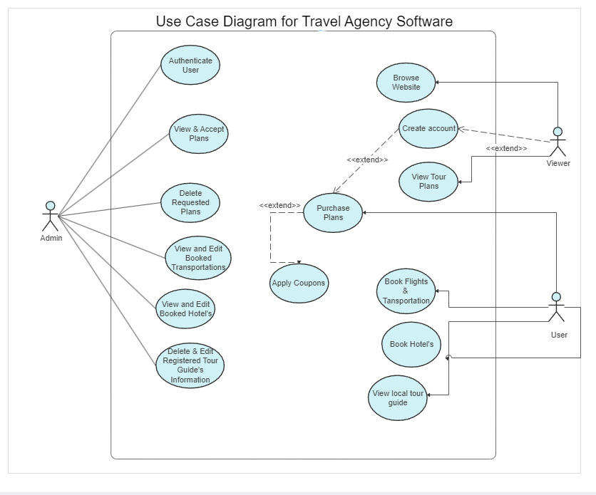
Use-Case Diagram
Oddesy Travels

Slide 15
Oddesy Travels
Data Flow Diagram

Slide 16
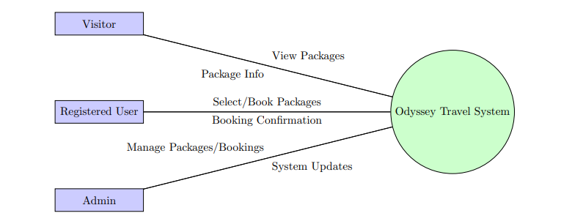
Level-0 DFD
Oddesy Travels

Slide 17
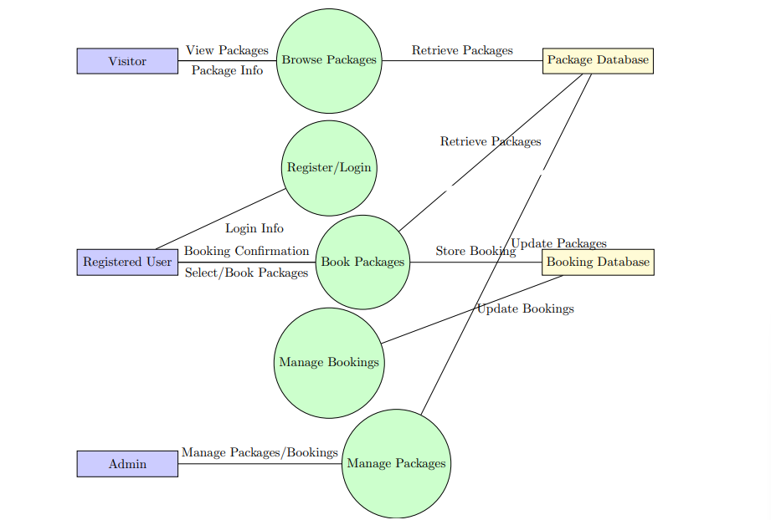
Level-1 DFD
Oddesy Travels

Slide 18


Oddesy Travels
Conclusion
Customer-Centric Approach
Functional Highlights
User Experience Focus
Robust Technological Foundation
Collaborative Partnerships
Meet in the
Future With Us
Customer Trust and Security
Invitation to Experience

Slide 19

Oddesy Travels
Thank You

